Slide 1
Generative AI & Society: Understanding the Impact
Ivan Taylor
And
Paco Araujo

Slide 2
Research Question
How can policymakers effectively address the potential impacts of generative AI tools on societal structures, institutions, and economics, while promoting responsible and equitable integration into diverse communities?

Slide 3
Intended Audience
The audience includes researchers, policymakers, and practitioners concerned with the responsible integration of AI technology.

Slide 4
Why is this important?
This research is crucial as the widespread adoption of generative AI tools may have significant consequences for social beliefs, knowledge dissemination, discourse, and institutions.

Slide 5
Hopes and Fears
Model can produce graphs to depict the adoption of AI tools, changes in social discourse quality, employment trends, the epistemological crisis index, and the sentiment analysis of AI-related discussions.

Slide 6
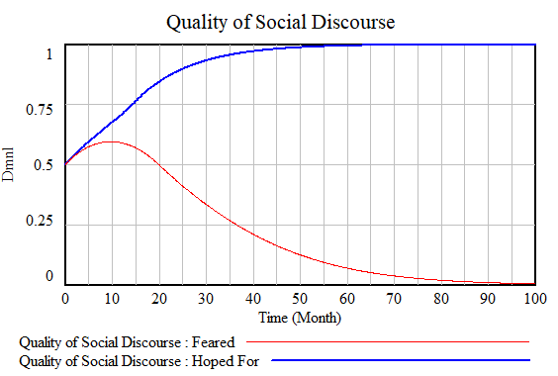
Example - Quality of Social Discourse

Slide 7
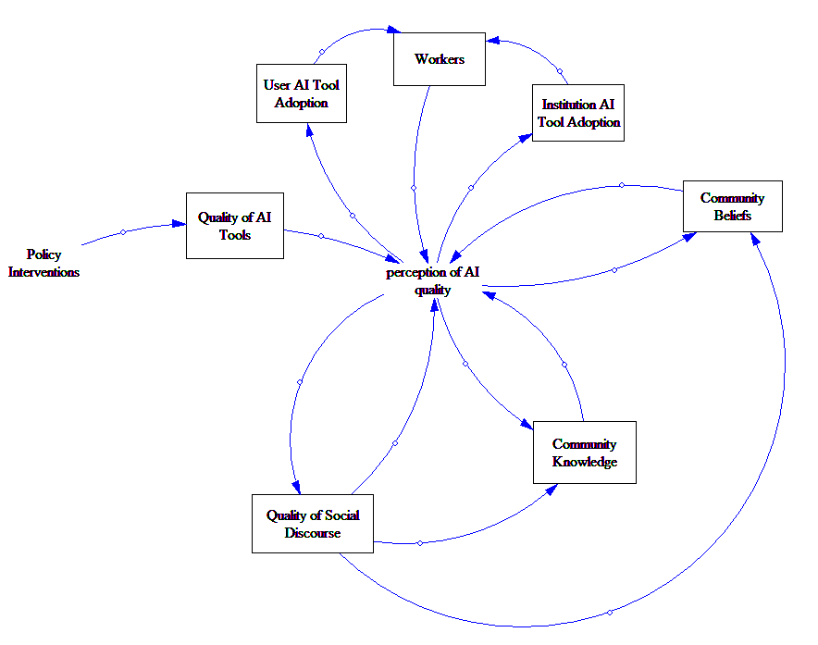
Dynamic Hypothesis

Slide 8
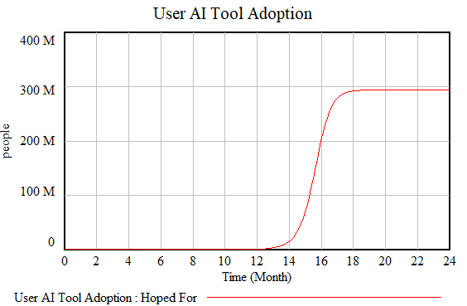
Calibration

Slide 9
Policies
Regulatory Guidelines for AI Transparency and Accountability
Quality Standards for AI-Generated Content
Ethical Use Guidelines
User Education and Awareness Programs
Support for Responsible AI Research
Employment Transition Programs
AI Governance Bodies
Public-Private Partnership

Slide 10
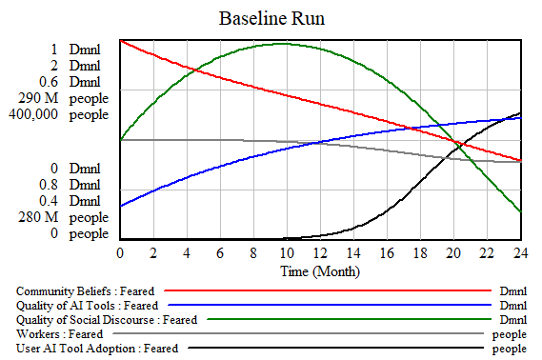
Without Policy Interventions

Slide 11
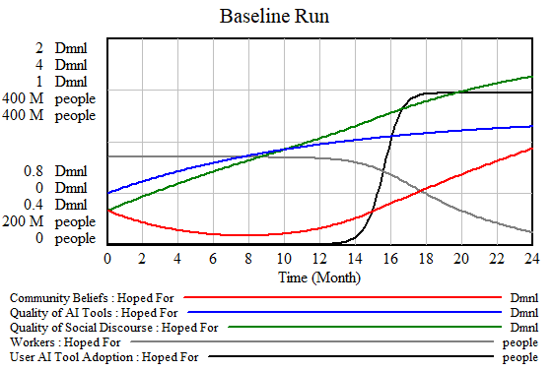
With Policy Interventions

Slide 12
Possible Unintended Consequences
Hinder Freedom of Expression
Missing the Root Cause of Misinformation
Short Term Profit Making Goals Ruin Reputation
Large Companies Can Comply More Easily Than Small Companies

Slide 13
Caveats
Simplified Representation
Limited Data
Many Assumptions
Limited Policy Exploration
Limited Human Factors
Homogeneous Communities
Policy Independence

Slide 14
Insights
The central issue is the perception of AI
Industry and Government may obtain AI Tool Quality which can improve the perception of AI
But Social Discourse and Community Beliefs may degrade the perception of AI
The perception of AI will impact User and Institution Adoption
AI Literacy and AI Education can support a positive perception of AI
Employment rates will impact the perception of AI

Slide 15
Thank you for your attention.
I would be happy to take questions at this time.
Or you can reach me at
ivan@policydynamics.ca

